Slide 1
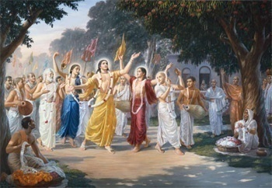
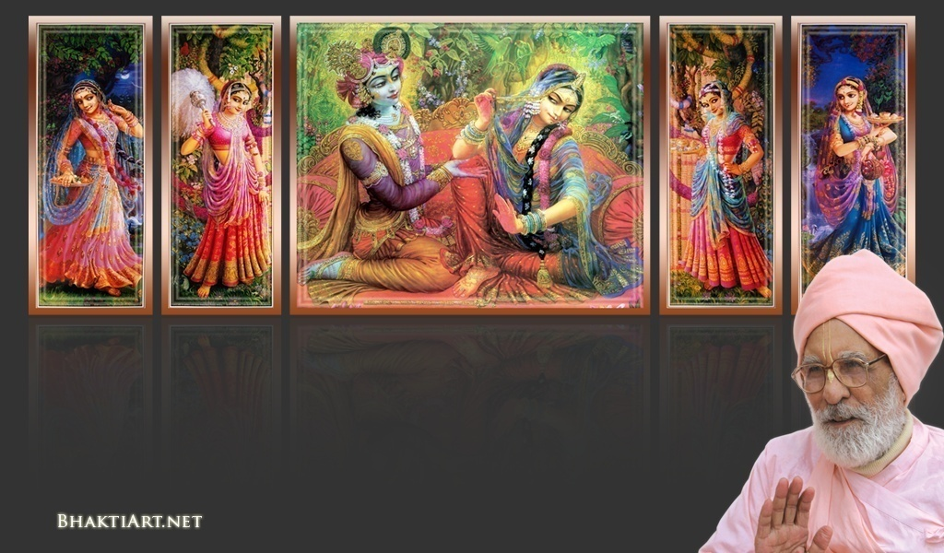
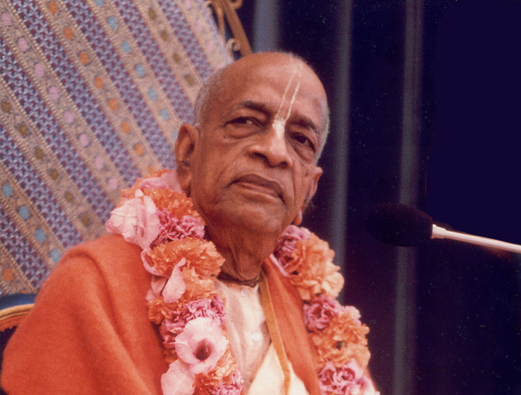
Sri Krsna Caitanya Prabhu Nityananda
Sri Advaita Gadadara Srivasadi
Gaura Bhakta Vrinda
Week# 253
Feb 22, 2013
Hare Krsna Hare Krsna
Krsna Krsna Hare Hare
Hare Rama Hare Rama
Rama Rama Hare Hare
Gokul Bhajan & Vedic Studies
North Carolina, USA
Notes:
Om Ajnana timirandhasya, jnananjana salakaya
Caksur unmimiltam yena, tasmai sri gurave namah
Namah om vishnu padaya, radhikayah priyatmane
Sri-srimad bhaktivedanta, narayana iti namine
Sri krishna lila kathane sudaksham
Audarya-madhurya gunais ca yuktam
Varam varenyam purusham mahantam
Narayanam tvam sirasa namami
He krishna karuna sindho, dina bandho jagat pate
Gopesha gopika kanta, radha kanta namo ‘stu te
tapta kancana gaurangi, radhe vrindavaneshvari
vrsabhanu sute devi, pranamami hari priye
bhajami radham aravinda netram
smarami radham madhurasmi-tasyam
vadami radham karuna bharardram
tato mam anyasti gatir na kapi
bhaktya vihina aparadha lakshai
ksiptas ca kamadi taranga madhye
krpamayi tvam saranam prapanna
vrinde numas te caranara vindam

Slide 2
Any one remember some of the great days that passed by ?
Valentines Day?

Slide 3
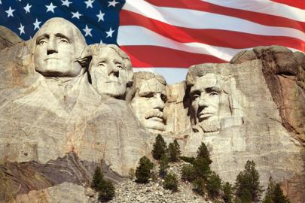
President’s Day?

Slide 4
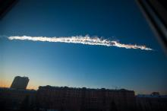
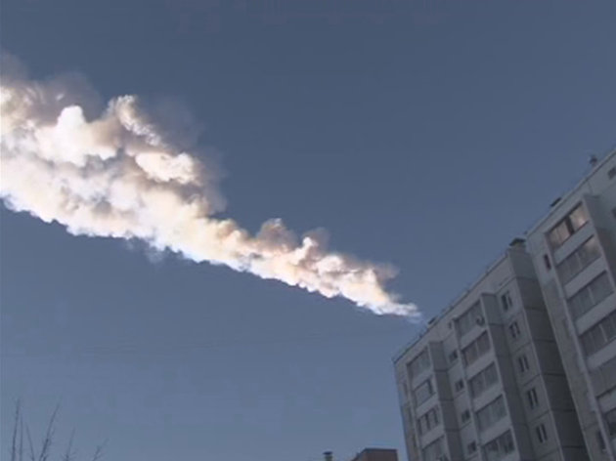
News: FEB 15, 2013: A meteorite with ton of weight exploded in Russia in the sky.
Mateorite Day?

Slide 5
Teacher’s Working Day?

Slide 6
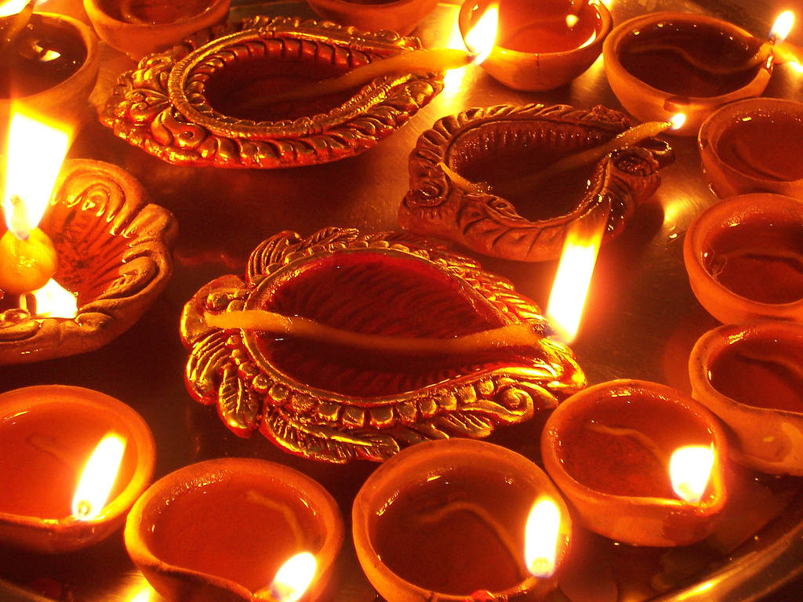
Holy Days..!

Slide 7
Feb 14
Vasanta Pancami
Srimati Visnupriya Devi ~ Appearance
Sri Pundarika Vidyanidhi ~ Appearance
Srila Raghunatha Dasa Gosvami ~ Appearance
Srila Visvanatha Cakravarti Thakura ~ Disapp

Slide 8
Sri Raghunandana Thakura ~ Appearance
Sri Bhakti Vivek Bharti Gosvami ~ Disapp
Sarasvati Puja
Feb 16:
Sri Advaita Acarya – Appearance day
Feb 19
Srila Madhvacarya's Disappearance Day
Today (Feb 22):
Sri Varaha – Appearance day

Slide 9
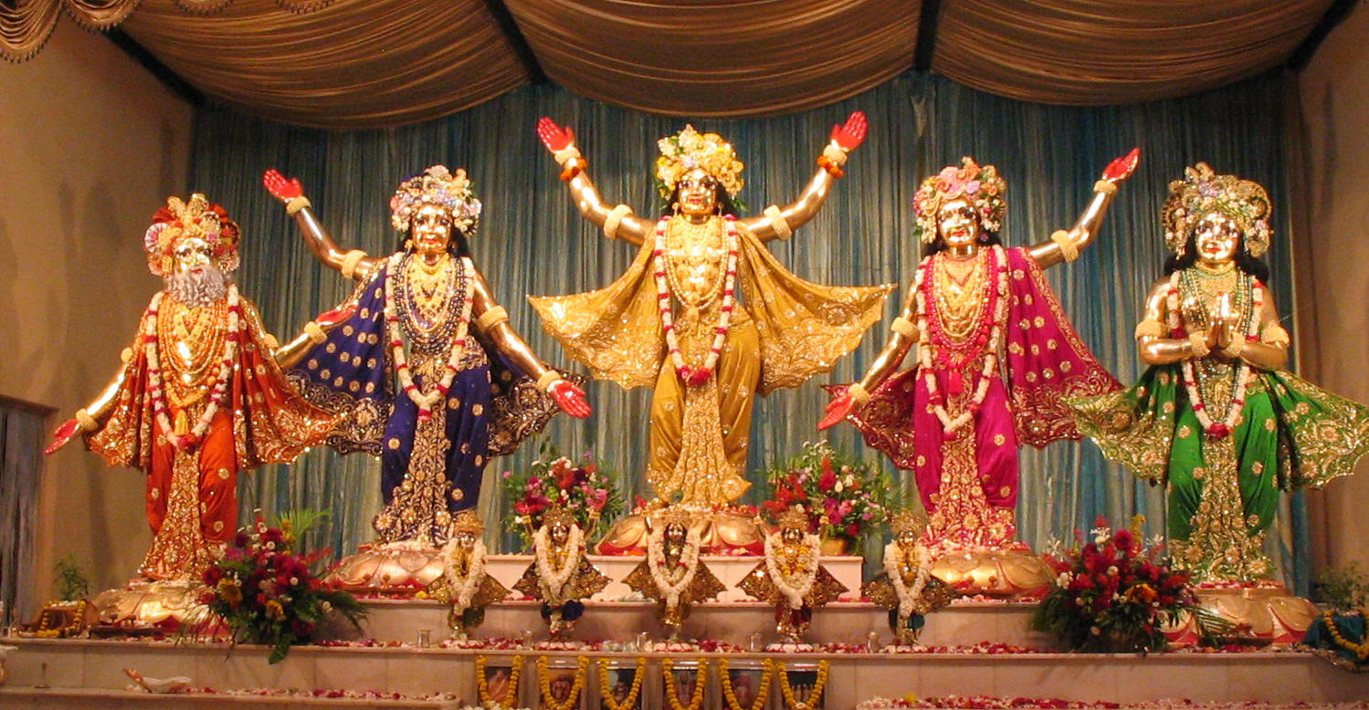
And tomorrow (Feb 23) is another auspicious day…

Slide 10
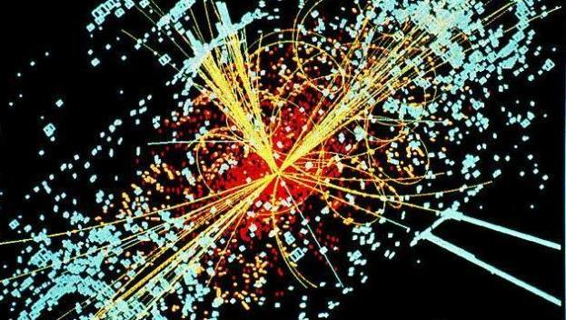
‘GOD’ Particle
Will Higgs boson ‘doom’ the universe in 50 billion years?
This is the one responsible for ‘mass’..
Scared?
Here are some reactions!

Slide 11
The ‘God particle’ Higgs boson will ‘doom’ the universe in
50 billion years – Breaking News
I am selling ‘Higgs boson Doom’ insurance. Interested?
But you scientists will destroy the planet very soon anyway!
I am very worried, because my wife wants me to work until then, and I planned my retirement around that time!
I didn't fully understand what the Higgs boson particle actually was...until my little dog explained it to me...He explained in three words, ”Wov, Wov, Wov“. He can always simplify even the most complicated facts. amazing.

Slide 12
The ‘God Particle’ Higgs boson ‘dooming’ the universe…
Found ‘God’ particle?, Why don’t they find ‘Dog’ particles? It will counteract the God particles!
I am glad that at least all the politicians will be destroyed!
Now I understand why Pope declared his resignation early!.
I do’not believe in God.. So how can I believe in ‘God’ particle! It does not exist!
What do you mean? Won’t be there any more Soap Opera?

Slide 13
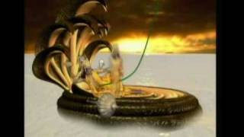
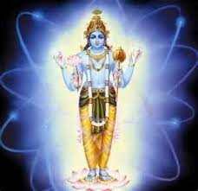
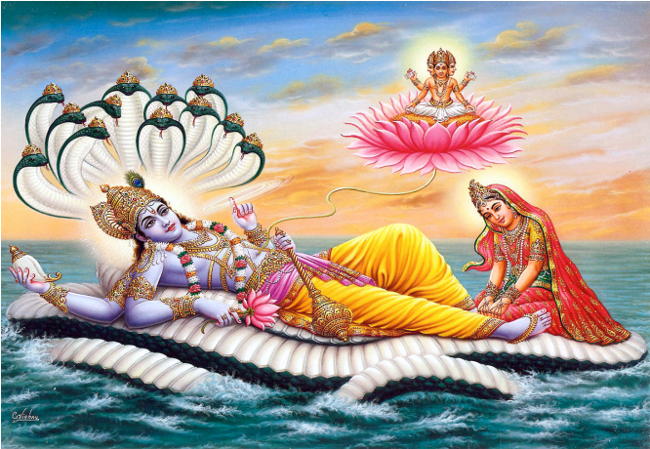
What is this Higgs Boson – the ‘God’ particle?
Kshirodakasayi Vishnu
Paramatma
Garbhodakasayi Vishnu
Vishnu
All-Pervading essence of all beings

Slide 14
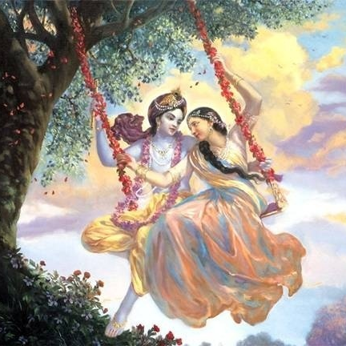
Jaya Rādha Mādhava
Jaya Kunja Vihārī
Jaya Gopī Jana Vallabha
Jaya Giri Vara Dhārī ... (Jaya)
Yaśodā Nandana Vraja Jana Ranjana
Yamunā tīra Vana Cāri ... (Jaya)
[ Hare Krishna Hare Krishna
Krishna Krishna Hare Hare
Hare Rāma Hare Rāma
Rāma Rāma Hare Hare ]

Slide 15
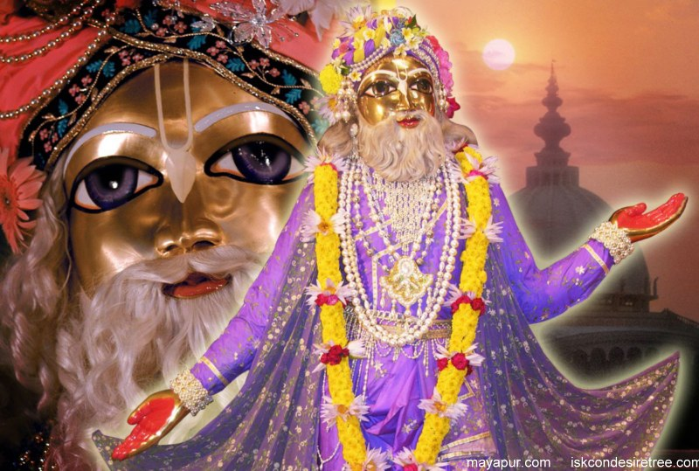
On Feb 16th, it was the appearance day of Sri Advaita Acharya

Slide 16
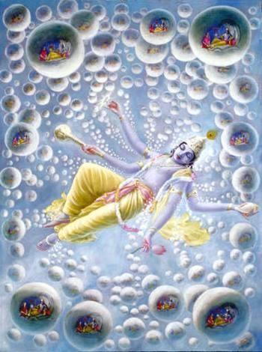
Who is Advaita Acharya?
Krishna
Baladev
Mula Sankarshana
Maha Sankarshana
Karanodakasayi Vishnu
Garbhodakasayi Visnu (exp. of Pradyumna)
Ksirodakasayi Visnu (exp. of Aniruddha)

Slide 17
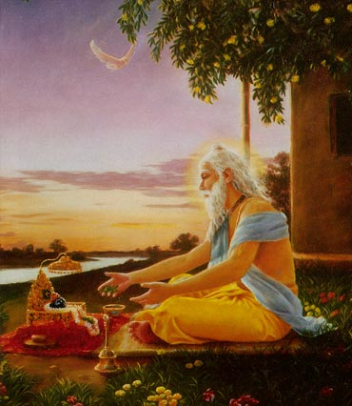
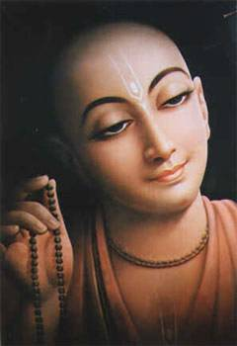
It was Sri Advaita Acharya who brought Krishna as Lord Caitanya Mahaprabhu

Slide 18
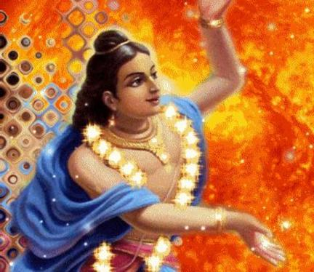
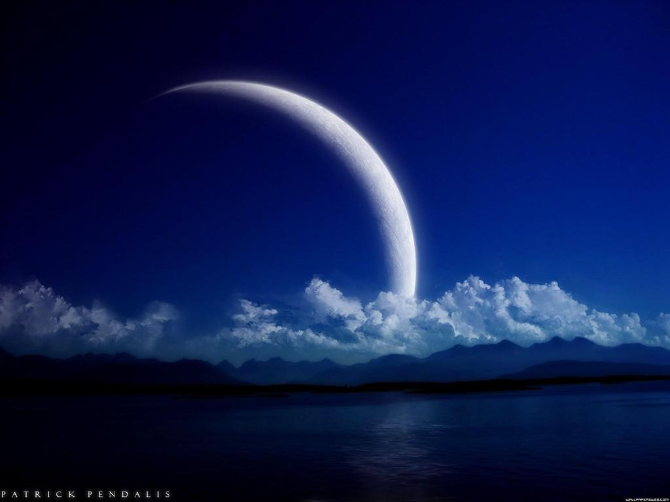
Tomorrow is the appearance day
Of Lord Nityananda

Slide 19
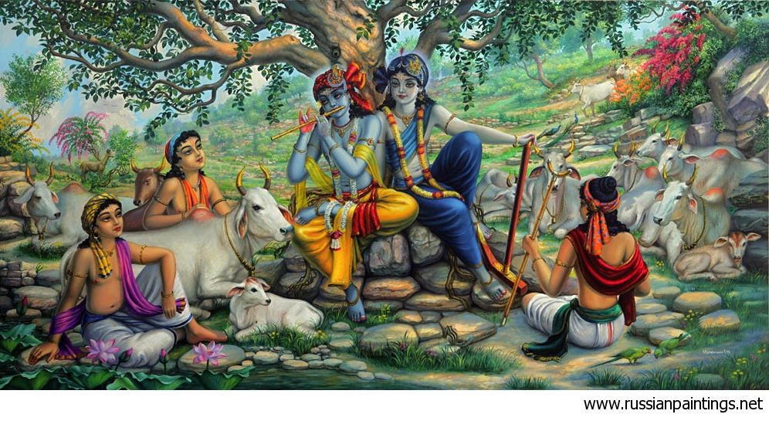
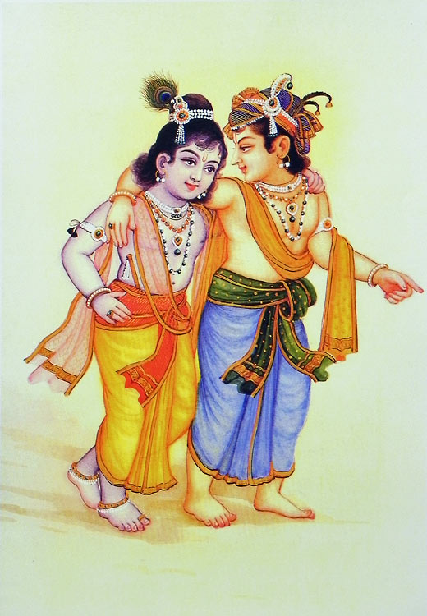
Who is Lord Nityananda?

Slide 20
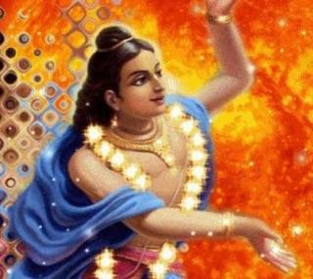
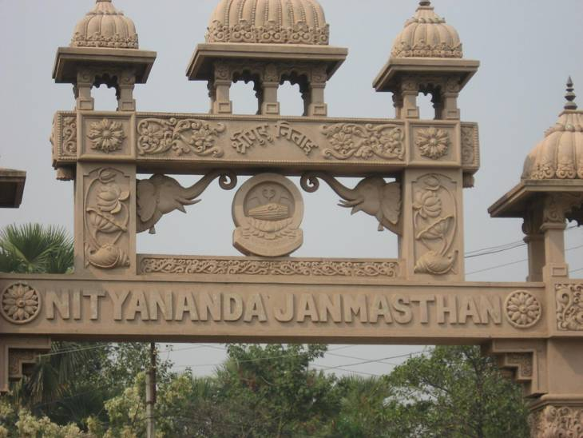
EKA CHAKRA
(Near Mayapur)
Where was Lord Nityananda born?

Slide 21
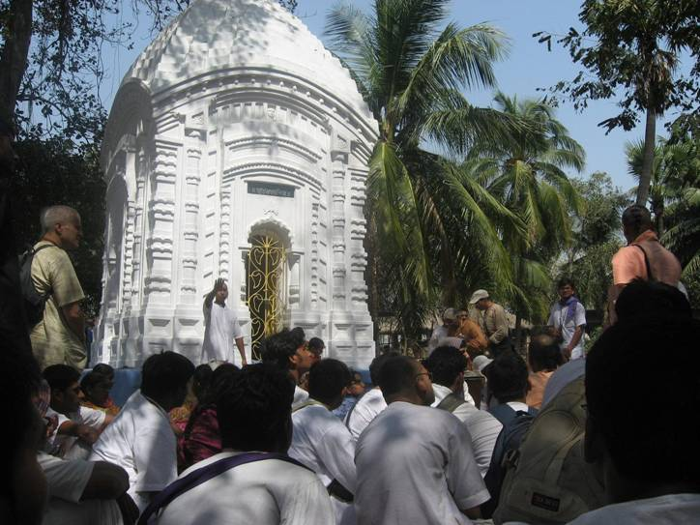
Appeared in 1474 AD in Ekachakra
Parents: Sri Hādāi Pandita & Padmāvati Devi.. (on Nityananda Triodasi day)
Exact spot where Lord Nityananda was born

Slide 22
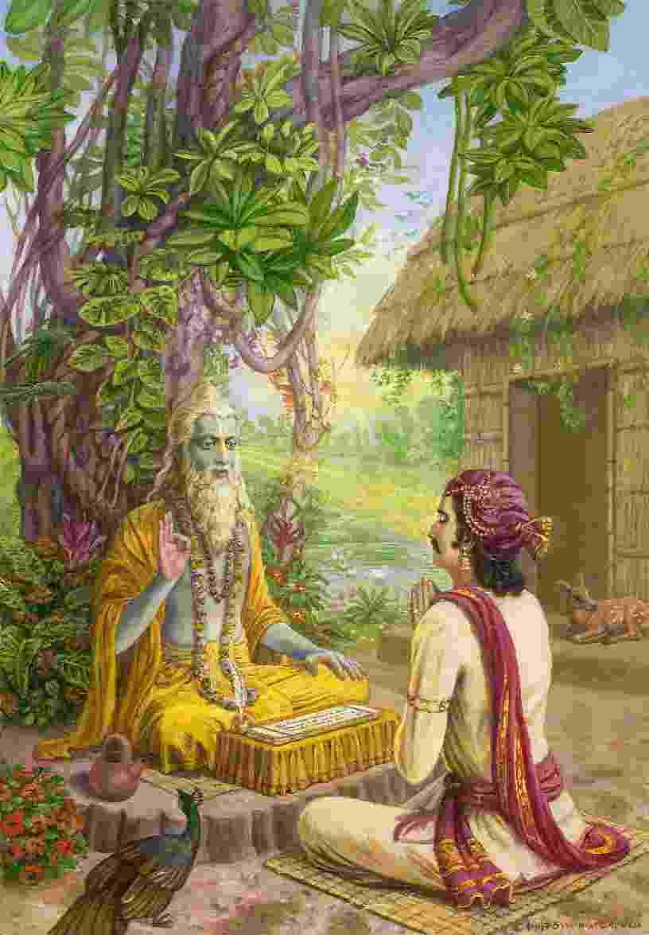
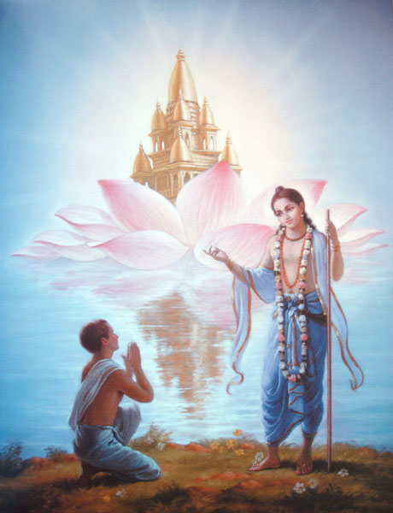
He is Guru Tattva

Slide 23
G1-07
Importance of guru for one’s spiritual perfection..
adīkṣitasya vāmoru kṛtaṁ sarvaṁ nirarthakam paśu-yonim avāpnoti dīkṣā-virahito janaḥ
(Hari Bhakti Vilasa 2.6)
“Unless one is initiated by a bona fide spiritual master, all his devotional activities are useless. A person who is not properly initiated can descend again into the animal (paśu) species."

Slide 24
Guru is the one who gives the Sambandha with Lord Krishna..
Vande devam sri gurum
Pāda padmam āśrayam
Krishna sambandham dadātvām
Sad gurave namo namah
(Gokul Bhajan)

Slide 25
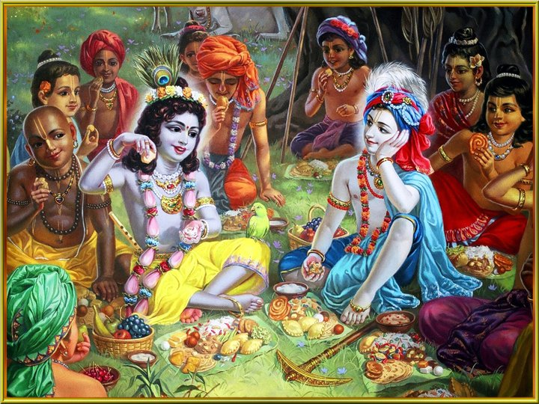
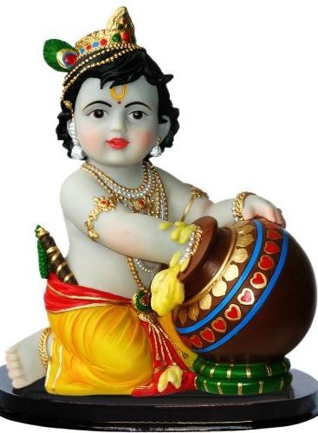

Slide 26
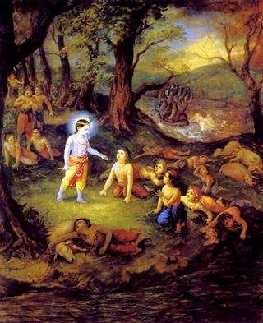
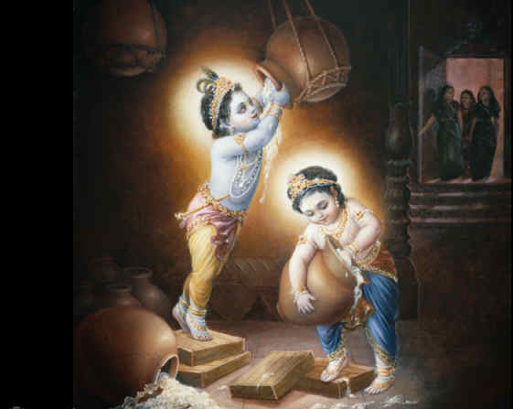

Slide 27
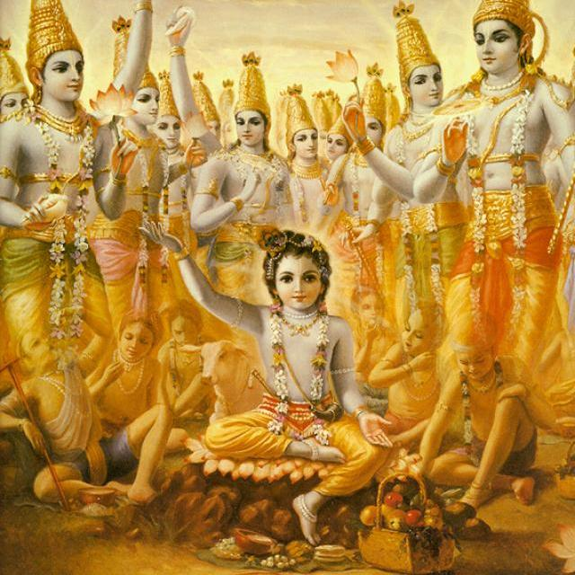
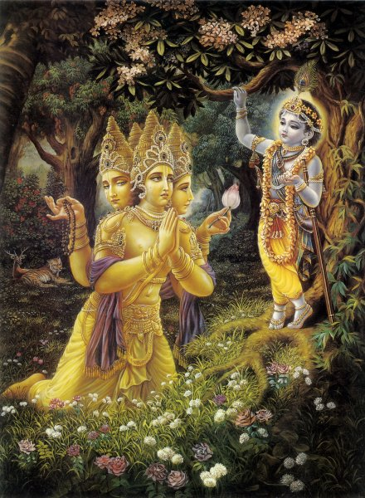
Brahma Vimohana

Slide 28
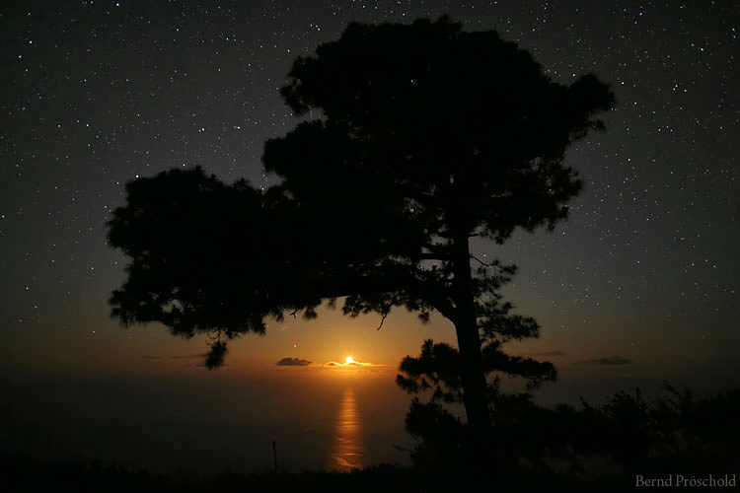
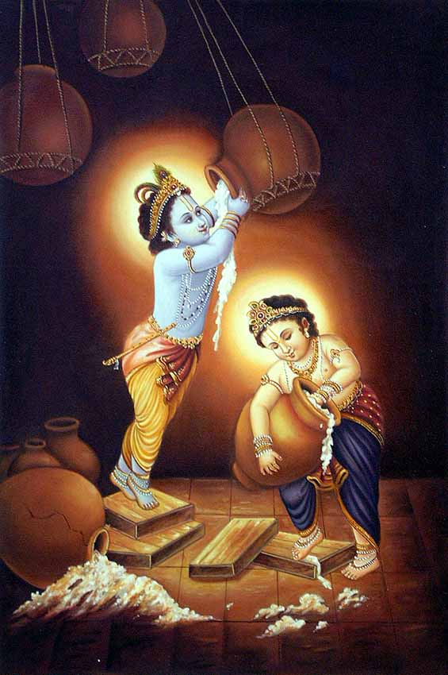
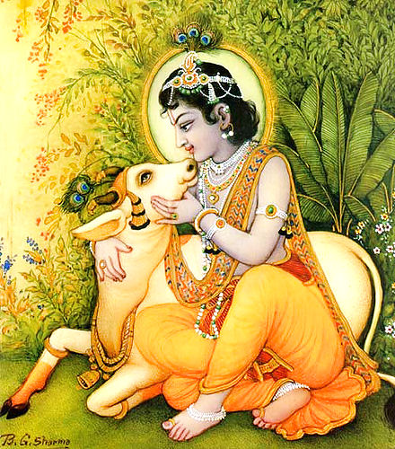
E-61
Lala Lala Nanda Lala
Bala Bala Gopala
Bambam Bola Bambam Bola
Bambam Bola
Bambam Bam(bam) Bambambam
Bambam Bola
Chora Chora Makhan Chora
Mera Mera Damodara

Slide 29
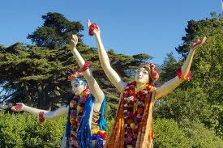
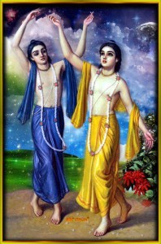
Lord Nityananda is very special
Once he tricked Lord Caitanya when going to Vrindavana!

Slide 30
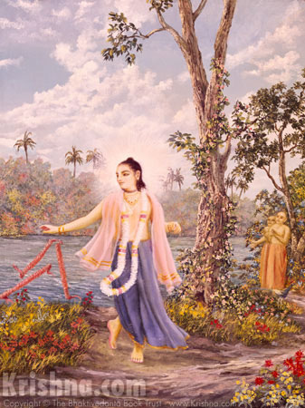
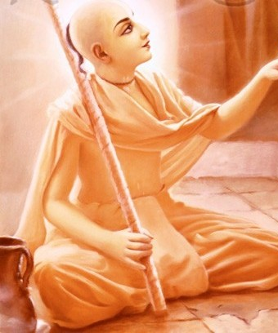
Once, Lord Nityananda also broke the danda of Lord Caitanya

Slide 31
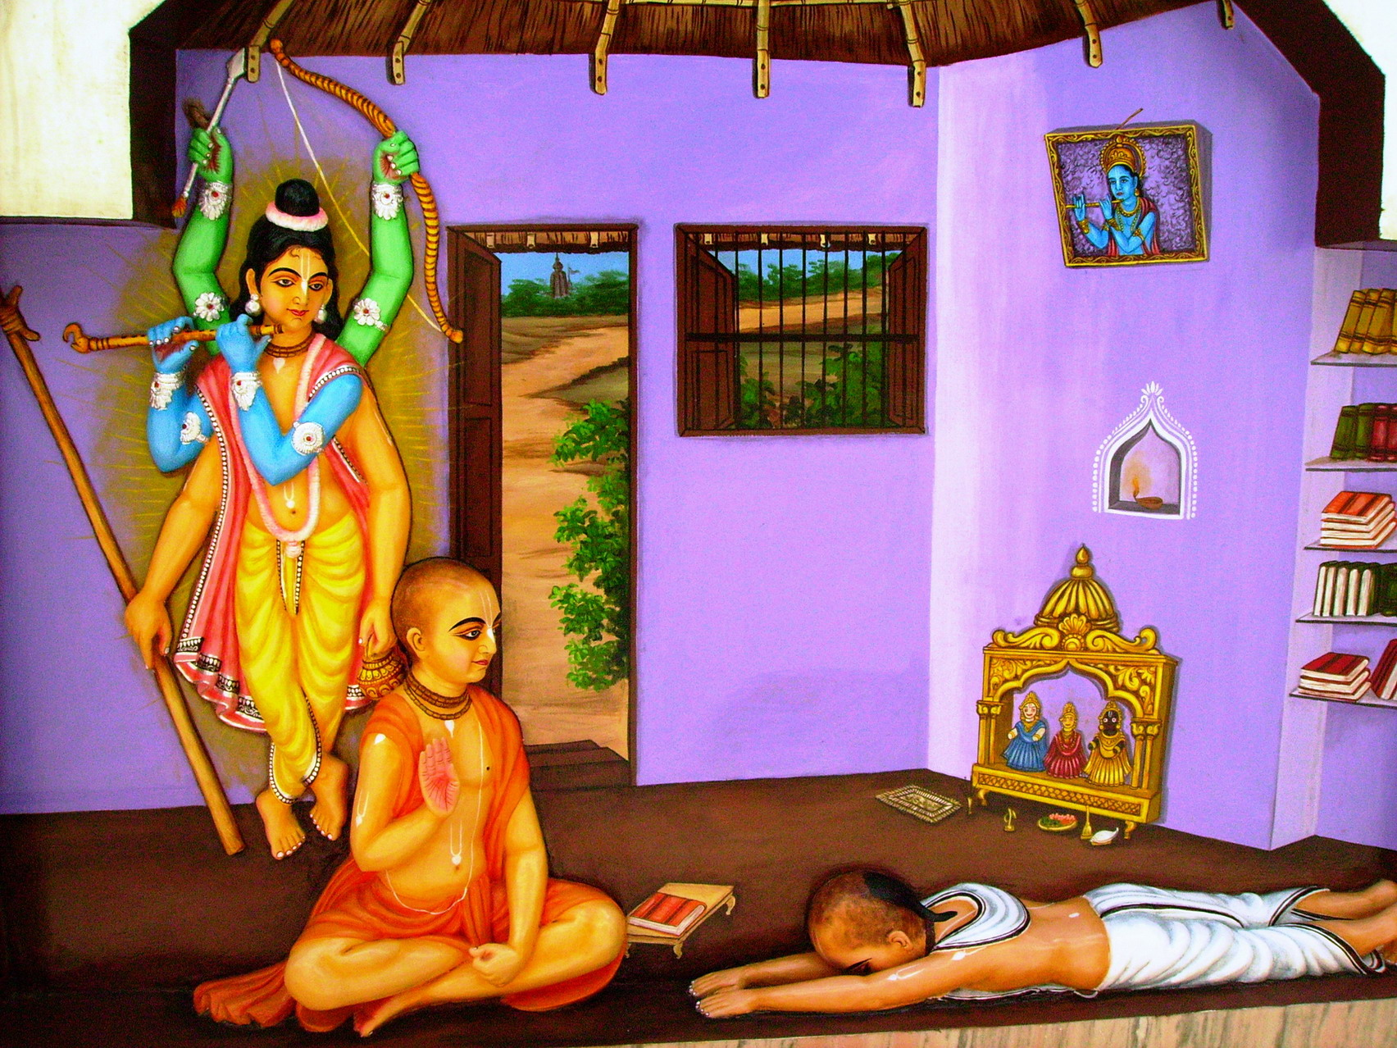
There were many reasons why Lord Caitanya took initiation under Maya Vadi Sanyasi..
Who is Sarva Bhauma Bhattacharya?

Slide 32
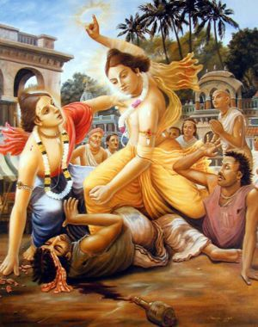
Lord Nityananda is more merciful
There is only one who can give Vraja Prema..
Lord Caitanya
Lord Nityananda
Guru

Slide 33
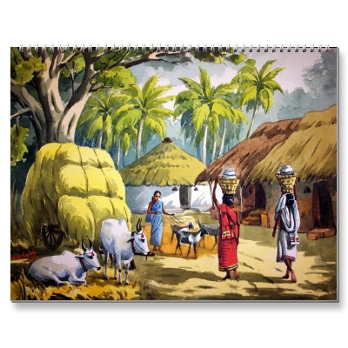
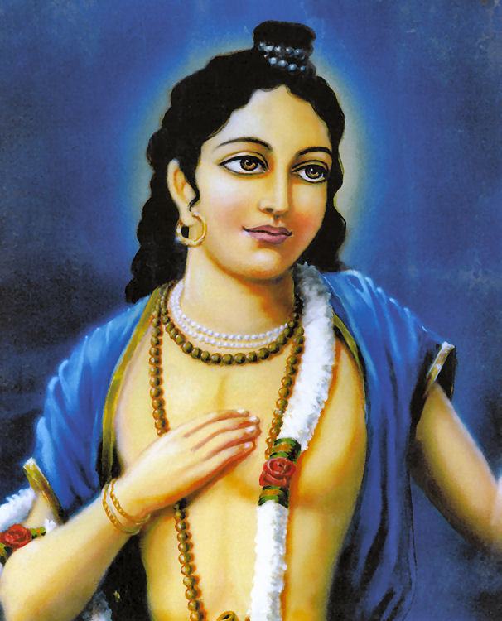
Went Door to Door!

Slide 34
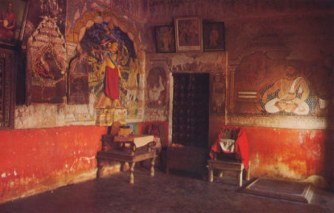
Why should they do all these things?
To save the fallen souls..!
Do you know where you will be after this life?
What kind of body we will have?

Slide 35
G2-06
Jalajā nava lakşāni
Sthāvarā lakşa vimśati
Krmayo rudra sankhyakah
Pakşiņām daśa lakşaņam
Trimsal lakşāni paśavah
Catur lakşāni mānuşah
(Padma Purana)
There are 900,000 kinds of aquatics, 2,000,000 kinds of trees and plants, 1,100,000 kinds of insects and reptiles, 1,000,000 kinds of birds, 3,000,000 kinds of four-legged beasts, and 400,000 kinds of human species.

Slide 36
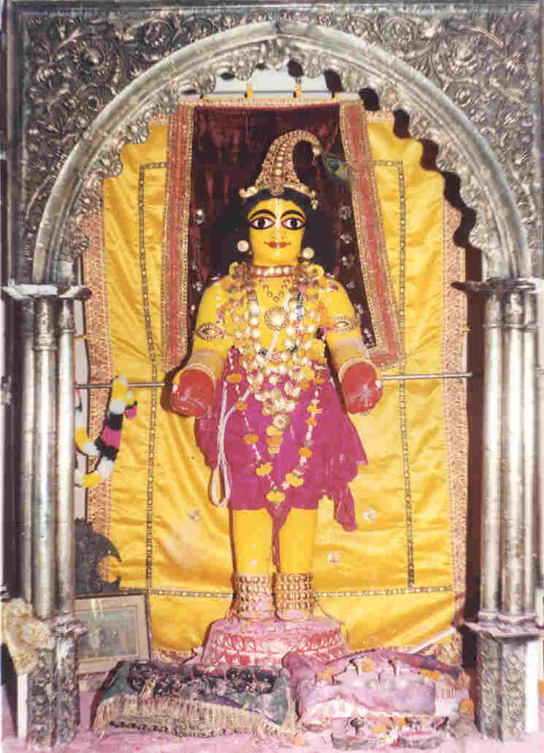
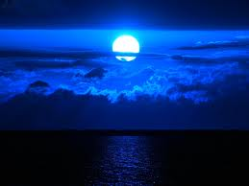
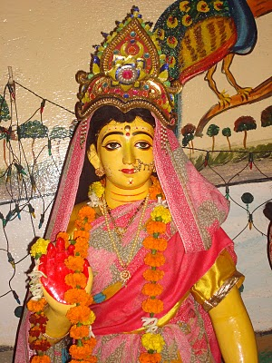
Appearance day of Sri Vishnu Priya Devi

Slide 37
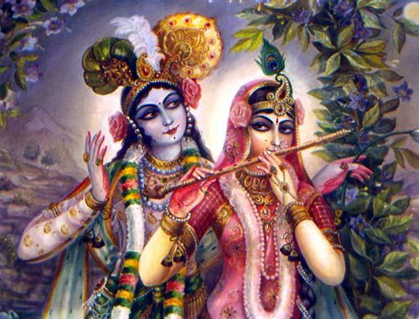
In Krishna Leela (Vrindavan)
Sri Devi → Candravali
Bhu Devi → Radha Rani
Nila Devi → Vraja Mandal

Slide 38
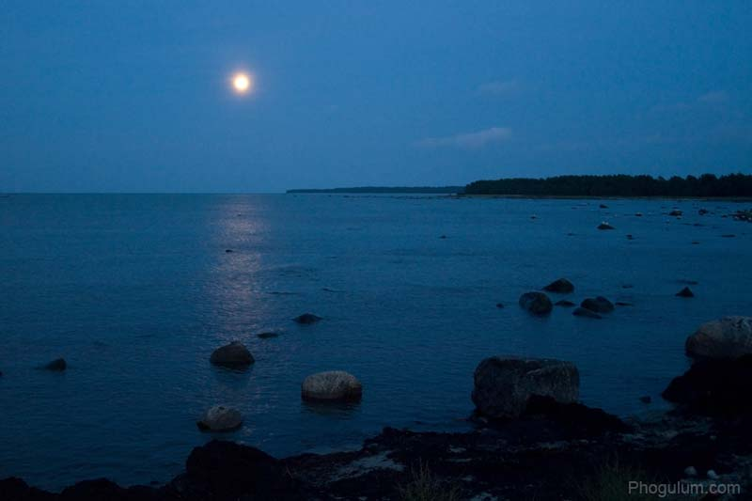
Krishna Leela - In Dwaraka
Sri Devi → Rukmini
Bhu Devi → Satyabhama
Nila Devi → Dwaraka

Slide 39
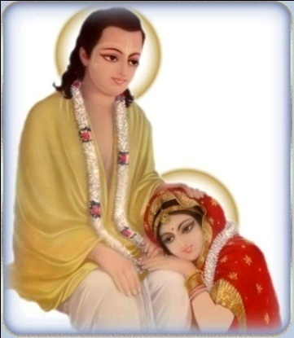
In Caitanya Leela
Sri Devi → Laxmi Priya
(Consort of Gaura Narayana – Sri Ananta conducted the marriage.)
Bhu Devi → Vishnu Priya
(Sri Vanamali conducted the marriage (who also did for Satyabhama in Krsna Leela)
Nila Devi → Nawadwip Dham

Slide 40
Who is Sita Devi

Slide 41
Vasanta Panchami

Slide 42
The Rasa leela lasted for one full night of Brahma (4.32 Billion earth years)

Slide 43
Jayati te 'dhikam janmana vrajah
Srayata indira sasvad atra hi
Dayita drsyatam diksu tavakas
Tvayi dhrtasavas tvam vicinvate

Slide 44
We should bring Vrindavan into our hearts…
The great saints came down to give this treasure..
Let Sri Radha and Krishna dance in our hearts with the gopis all the times!

Slide 45
[Radha Nache, Krsna Nache, Nache Gopi Gan
Man Mera (Sakhi) Van Gaia Ri Pavana Vrindavan]
[Yamuna Nache, Ganga Nache, Nache Nadi Gan
Man Mera (Sakhi) Van Gaia Ri Pavana Vrindavan]
[Pavana Teri Nam, (Sakhi Ri) Pavana Vrindavan
Man Mera (Sakhi) Van Gaia Ri Pavana Vrindavan]
[Lalita Nache, Vishaka Nache, Nache Sakhi Gan
Man Mera (Sakhi) Van Gaia Ri Pavana Vrindavan]
[Sukha Nache, Sari Nache, Nache Pakshi Gan
Man Mera (Sakhi) Van Gaia Ri Pavana Vrindavan]
[Pavana Teri Nam, (Sakhi Ri) Pavana Yamuna
Man Mera (Sakhi) Van Gaia Ri Pavana Vrindavan]

Slide 46
Sri Krsna Caitanya Prabhu Nityananda
Sri Advaita Gadadara Srivasadi
Gaura Bhakta Vrinda
THANK
YOU!
Hare Krsna Hare Krsna
Krsna Krsna Hare Hare
Hare Rama Hare Rama
Rama Rama Hare Hare
Vancha-kalpa-tarubhyash cha, Kripa-sindhubhya eva cha
Patitanam pavanebhyo, Vaishnavebhyo namo namaha
Notes:
Om Ajnana timirandhasya, jnananjana salakaya
Caksur unmimiltam yena, tasmai sri gurave namah
Namah om vishnu padaya, radhikayah priyatmane
Sri-srimad bhaktivedanta, narayana iti namine
Sri krishna lila kathane sudaksham
Audarya-madhurya gunais ca yuktam
Varam varenyam purusham mahantam
Narayanam tvam sirasa namami
He krishna karuna sindho, dina bandho jagat pate
Gopesha gopika kanta, radha kanta namo ‘stu te
tapta kancana gaurangi, radhe vrindavaneshvari
vrsabhanu sute devi, pranamami hari priye
bhajami radham aravinda netram
smarami radham madhurasmi-tasyam
vadami radham karuna bharardram
tato mam anyasti gatir na kapi
bhaktya vihina aparadha lakshai
ksiptas ca kamadi taranga madhye
krpamayi tvam saranam prapanna
vrinde numas te caranara vindam

